Slide 1
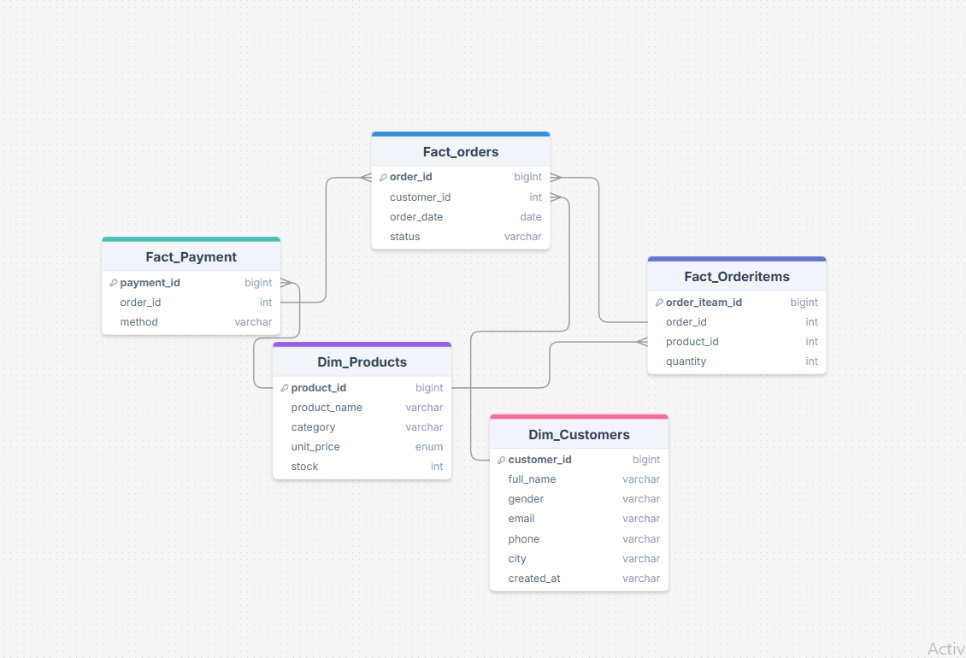
UrbanCart Sales Analytics: SQL-Based Business Insights Project
Overview:
UrbarChart is a growing online retail operating company across the cities. The main focus of this is company is selling the best quality product to the customer.
The company want to improve operation by analyzing sales, customers, revenue, products and purchasing behavior.
ER Diagram :

Slide 2


Q1. How many total orders has UrbanCart received so far?
1200 Order has urbenchart received.
Q2. How many unique customers have placed at least one order?
100 unique customers have placed at least one order.

Slide 3
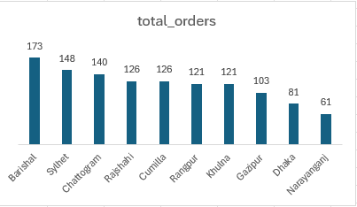

Q3. Which cities generate the highest number of orders?
Barishal,generate the highest number of orders.
Q4. What percentage of customers have placed more than one order?
100% of customer have placed more then one order

Slide 4
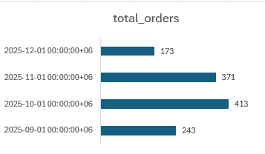

Q5. What is the monthly trend of total orders over time?
In January 10 we get highest number of order, it was 413. on the other hand, second highest number of is 371 on January 11.
Q6.What is the total revenue generated by UrbanCart?
2,245,122 taka is total revenue generated by urbanchart

Slide 5
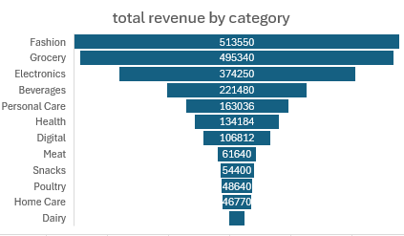
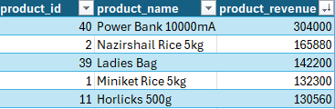
Q7.Which product categories contribute the most to total revenue?
Fashion category products generated highest amount of revenue. On the other hand dairy category products generate lowest amount of revenue.
Q8.Which individual products generate the highest revenue?
Here, power bank are products in the electronic category. its generate highest revenue among individual product. At the same time, grocery items and ladis items also generated good revenue.

Slide 6

Q9.What is the Average Order Value (AOV) and Average Basket Size?
The Average Order Value (AOV) represents the average monetary value of each customer order. Based on the analysis, the AOV is 1,870.94, indicating that, on average, customers spend 1,870.94 per transaction.

Slide 7
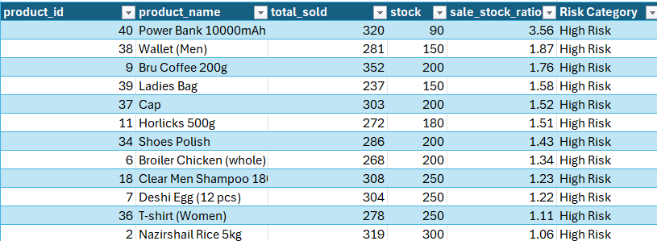
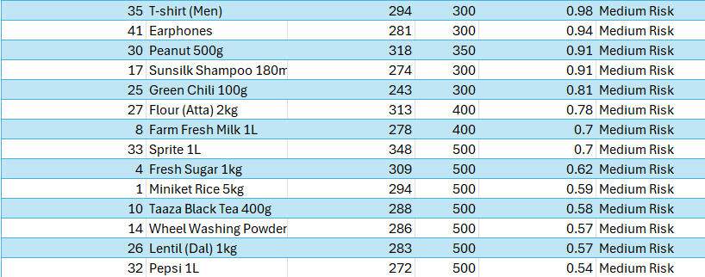
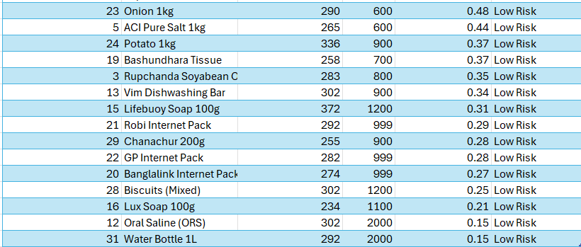
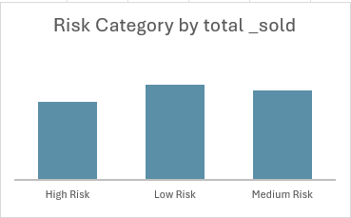
Q10.Which products are at risk of stock-out due to high sales volume and low inventory?
The distribution shows that while High Risk products contribute a significant share of total sales, a large portion of demand is still driven by Low and Medium Risk items with healthier inventory levels. However, the High Risk category represents the most critical operational concern, as these products combine strong sales demand with insufficient stock. Immediate replenishment actions should focus on High Risk items, while Medium Risk products should be monitored to prevent future stock-outs.

Slide 8
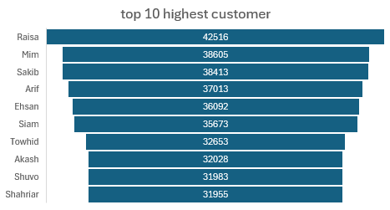

Q11.Which customers contribute the highest total revenue?
Here are the top 10 customers are contribute the highest total revenue
Q12.What is the average number of products purchased per order?
9.96 the average number of products purchased per order

Slide 9
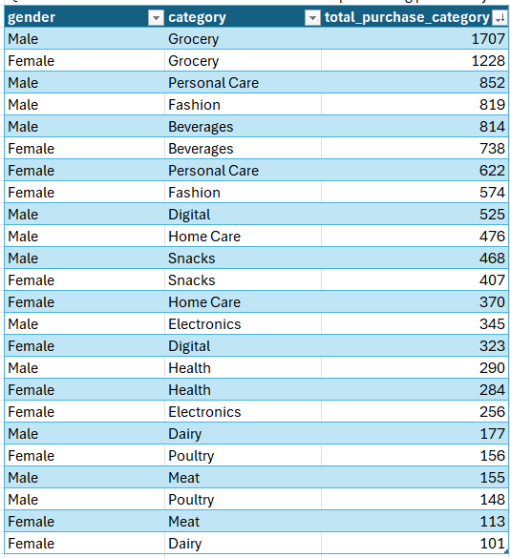
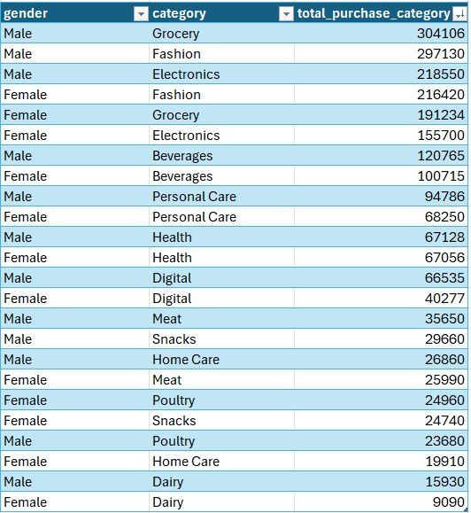
Q13.Do male and female customers show different purchasing patterns by category?
Quantity-based purchasing pattern
Revenue-based pattern
Male customers purchase higher quantities across most categories, while female customers show relatively stronger demand in beverages and comparable behaviour in health and fresh food categories.

Slide 10
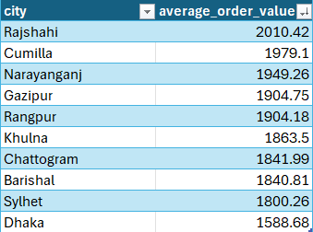
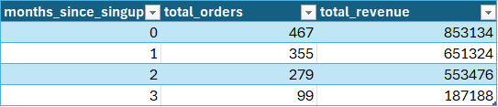
Q14.Which cities have the highest average order value (AOV)
Rajsahi have highest average order valu.
Q15.How does customer purchasing behaviour change over time since account creation?
Customer purchasing behaviour is highest immediately after account creation. New customers (0 years) placed 467 orders and generated 853,134 in revenue, while customers with 3 years since creation placed only 99 orders and generated 187,188. This shows a steady decline in both engagement and spending as customer tenure increases. The results suggest the need for retention and re-engagement strategies to sustain long-term customer value.

Slide 11
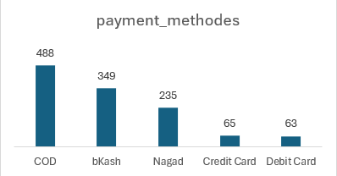
Q16.Which payment methods are used most frequently?
The results show that customers strongly prefer COD and mobile wallet payments, while card-based payments remain relatively unpopular. Businesses should continue supporting COD and mobile wallets while promoting card payments through incentives and improved payment experiences.

Slide 12
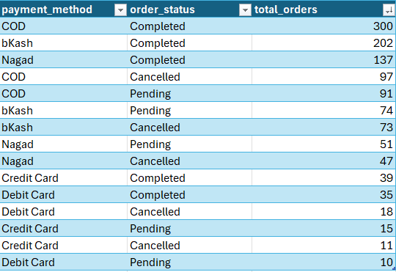
Q17.Is there any relationship between payment method and order status?
The analysis indicates that payment method significantly influences order outcomes. Digital and card-based payments tend to have higher completion reliability, while Cash on Delivery shows a higher cancellation and pending rate. This suggests that encouraging digital payments could improve order completion rates and reduce operational risk.

Slide 13
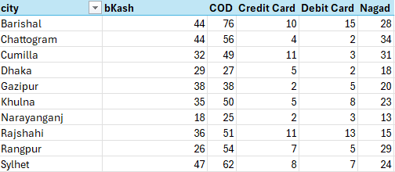
Q18.Do certain cities prefer specific payment methods?
The results confirm that payment preferences vary by city. While COD dominates in every city, mobile wallet payments such as bKash and Nagad show strong regional adoption. Card-based payments remain the least preferred method across all locations. This suggests that businesses should prioritize COD and mobile wallet support while selectively promoting card payments in major urban centres.

Slide 14
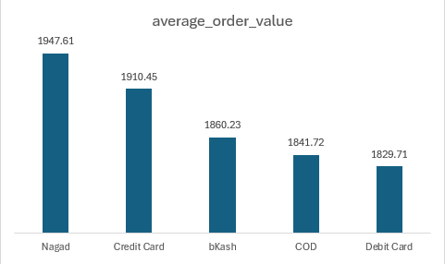
Q19.Are higher-value orders associated with specific payment methods?
Higher-value orders are more strongly associated with digital wallet (Nagad) and credit card payments. This suggests that customers who use these payment methods are generally higher-spending customers. Encouraging the use of these payment options may help increase overall transaction value.

Slide 15
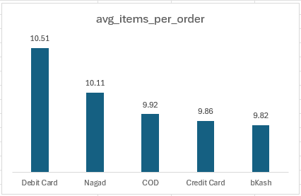
Q20.What is the average number of items per order by payment method?
Debit Card and Nagad users tend to buy slightly more items per order, whereas bKash users place marginally smaller baskets. This insight can be used to design targeted promotions or bundle offers by payment method.

Slide 16
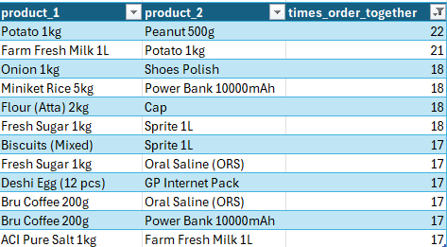
Q21. Which products are most frequently ordered together?
The analysis shows strong product pairing behaviour, especially among grocery and snacks, creating valuable opportunities for bundling, cross-selling, and personalized promotions.

Slide 17
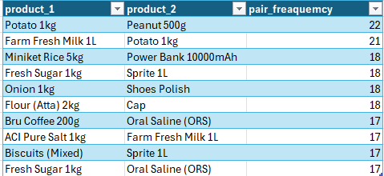
Q22. Which product pairs appear most often across all orders?
This analysis show stong pairs appear most often across all orders. especially among grocery and snacks items were ordered more together

Slide 18
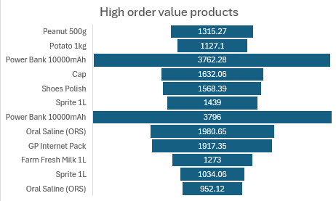
Q23. Are there product pairs that consistently drive higher order values?
Certain product pairs, especially those combining electronics with grocery or apparel items, consistently drive higher order values. The highest-value pairs are dominated by “Power Bank 10000mAh” combinations, indicating strong cross-selling potential and opportunities for bundle promotions.

Slide 19
SQL queries
Q1. How many total orders has UrbanCart received so far?
SELECT COUNT(order_id) AS total_ordersFROM public."FactOrders ";--
Q2. How many unique customers have placed at least one order?
SELECT COUNT(DISTINCT customer_id) AS unique_customersFROM public."FactOrders ";--
Q3. Which cities generate the highest number of orders?
SELECT c.city, COUNT(o.order_id) AS total_ordersFROM public."FactOrders " oJOIN public."DimCustomers" c ON o.customer_id = c.customer_idGROUP BY c.cityORDER BY total_orders DESC;--
Q4. What percentage of customers have placed more than one order?
WITH customer_orders AS ( SELECT customer_id, COUNT(order_id) AS order_count FROM public."FactOrders " GROUP BY customer_id),repeat_customers AS ( SELECT COUNT(*) AS repeat_count FROM customer_orders WHERE order_count > 1),total_customers AS ( SELECT COUNT(DISTINCT customer_id) AS total_count FROM public."FactOrders ")SELECT ROUND( (repeat_customers.repeat_count::NUMERIC / total_customers.total_count) * 100, 2 ) AS repeat_customer_percentageFROM repeat_customers, total_customers;--
Q5. What is the monthly trend of total orders over time?
SELECT DATE_TRUNC('month', order_date) AS order_month, COUNT(order_id) AS total_ordersFROM public."FactOrders "GROUP BY order_monthORDER BY order_month;

Slide 20
Q6.What is the total revenue generated by UrbanCart?
SELECT SUM(oi.quantity * p.unit_price) AS total_revenueFROM public."FactOrderitems" oiJOIN public."DimProducts " p ON oi.product_id = p.product_id;
-- Q7Which product categories contribute the most to total revenue?
SELECT p.category, SUM(oi.quantity * p.unit_price) AS category_revenueFROM public."FactOrderitems" oiJOIN public."DimProducts " p ON oi.product_id = p.product_idGROUP BY p.categoryORDER BY category_revenue DESC;--
Q8Which individual products generate the highest revenue?
SELECT p.product_id, p.product_name, SUM(oi.quantity * p.unit_price) AS product_revenueFROM public."FactOrderitems" oiJOIN public."DimProducts " p ON oi.product_id = p.product_idGROUP BY p.product_id, p.product_nameORDER BY product_revenue DESC;
-- Q9What is the Average Order Value (AOV) and Average Basket Size?
WITH order_metrics AS ( SELECT oi.order_id, SUM(oi.quantity * p.unit_price) AS order_revenue, SUM(oi.quantity) AS total_items FROM public."FactOrderitems" oi JOIN public."DimProducts " p ON oi.product_id = p.product_id GROUP BY oi.order_id)SELECT ROUND(AVG(order_revenue), 2) AS average_order_value, ROUND(AVG(total_items), 2) AS average_basket_sizeFROM order_metrics;
-- Q10Which products are at risk of stock-out due to high sales volume and low inventory?
WITH product_sales AS ( SELECT p.product_id, p.product_name, SUM(oi.quantity) AS total_sold, p.stock FROM public."FactOrderitems" oi JOIN public."DimProducts " p ON oi.product_id = p.product_id GROUP BY p.product_id, p.product_name, p.stock)SELECT product_id, product_name, total_sold, stock, ROUND(total_sold::NUMERIC / NULLIF(stock, 0), 2) AS sales_stock_ratioFROM product_salesWHERE stock > 0ORDER BY sales_stock_ratio DESC;

Slide 21
Q11Which customers contribute the highest total revenue?
SELECT c.customer_id, c.full_name, c.email, SUM(oi.quantity * p.unit_price) AS total_revenueFROM public."FactOrders " oJOIN public."DimCustomers" c ON o.customer_id = c.customer_idJOIN public."FactOrderitems" oi ON o.order_id = oi.order_idJOIN public."DimProducts " p ON oi.product_id = p.product_idGROUP BY c.customer_id, c.full_name, c.emailORDER BY total_revenue DESC;
-- Q12What is the average number of products purchased per order?
WITH order_item_counts AS ( SELECT order_id, SUM(quantity) AS total_items FROM public."FactOrderitems" GROUP BY order_id)SELECT ROUND(AVG(total_items)::NUMERIC, 2) AS avg_products_per_orderFROM order_item_counts;-- alternativeSELECT AVG(total_items) AS avg_products_per_orderFROM ( SELECT order_id, SUM(quantity) AS total_items FROM public."FactOrderitems" GROUP BY order_id) t;
-- Q13Do male and female customers show different purchasing patterns by category?
-- Quantity-based purchasing pattern
SELECT c.gender, p.category, SUM(oi.quantity) AS total_quantity_purchasedFROM public."FactOrders " oJOIN public."DimCustomers" c ON o.customer_id = c.customer_idJOIN public."FactOrderitems" oi ON o.order_id = oi.order_idJOIN public."DimProducts " p ON oi.product_id = p.product_idGROUP BY c.gender, p.categoryORDER BY c.gender, total_quantity_purchased DESC;
--Revenue-based pattern
SELECT c.gender, p.category, SUM(oi.quantity * p.unit_price) AS total_revenueFROM public."FactOrders " oJOIN public."DimCustomers" c ON o.customer_id = c.customer_idJOIN public."FactOrderitems" oi ON o.order_id = oi.order_idJOIN public."DimProducts " p ON oi.product_id = p.product_idGROUP BY c.gender, p.categoryORDER BY c.gender, total_revenue DESC;
-- Q14Which cities have the highest average order value (AOV)
WITH order_revenue AS ( SELECT o.order_id, c.city, SUM(oi.quantity * p.unit_price) AS order_value FROM public."FactOrders " o JOIN public."DimCustomers" c ON o.customer_id = c.customer_id JOIN public."FactOrderitems" oi ON o.order_id = oi.order_id JOIN public."DimProducts " p ON oi.product_id = p.product_id GROUP BY o.order_id, c.city)SELECT city, ROUND(AVG(order_value)::NUMERIC, 2) AS average_order_valueFROM order_revenueGROUP BY cityORDER BY average_order_value DESC;
-- Q15How does customer purchasing behavior change over time since account creation?
WITH customer_orders AS ( SELECT c.customer_id, TO_DATE(c.created_at, 'YYYY-MM-DD') AS created_at, o.order_id, o.order_date, DATE_PART( 'month', AGE( o.order_date, TO_DATE(c.created_at, 'YYYY-MM-DD') ) ) AS months_since_signup FROM public."DimCustomers" c JOIN public."FactOrders " o ON c.customer_id = o.customer_id),order_revenue AS ( SELECT co.customer_id, co.order_id, co.months_since_signup, SUM(oi.quantity * p.unit_price) AS order_value FROM customer_orders co JOIN public."FactOrderitems" oi ON co.order_id = oi.order_id JOIN public."DimProducts " p ON oi.product_id = p.product_id GROUP BY co.customer_id, co.order_id, co.months_since_signup)SELECT months_since_signup, COUNT(DISTINCT order_id) AS total_orders, ROUND(SUM(order_value)::NUMERIC, 2) AS total_revenueFROM order_revenueGROUP BY months_since_signupORDER BY months_since_signup;

Slide 22
Q16Which payment methods are used most frequently?
SELECT method AS payment_method, COUNT(payment_id) AS usage_countFROM public."FactPayment"GROUP BY methodORDER BY usage_count DESC;
-- Q17Is there any relationship between payment method and order status?
SELECT p.method AS payment_method, o.status AS order_status, COUNT(o.order_id) AS total_ordersFROM public."FactOrders " oJOIN public."FactPayment" p ON o.order_id = p.order_idGROUP BY p.method, o.statusORDER BY p.method, total_orders DESC;
-- Q18Do certain cities prefer specific payment methods?
SELECT c.city, p.method AS payment_method, COUNT(o.order_id) AS total_ordersFROM public."DimCustomers" cJOIN public."FactOrders " o ON c.customer_id = o.customer_idJOIN public."FactPayment" p ON o.order_id = p.order_idGROUP BY c.city, p.methodORDER BY c.city, total_orders DESC;
-- Q19Are higher-value orders associated with specific payment methods?
WITH order_revenue AS ( SELECT o.order_id, SUM(oi.quantity * p.unit_price) AS order_value FROM public."FactOrders " o JOIN public."FactOrderitems" oi ON o.order_id = oi.order_id JOIN public."DimProducts " p ON oi.product_id = p.product_id GROUP BY o.order_id)SELECT fp.method AS payment_method, ROUND(AVG(orv.order_value)::NUMERIC, 2) AS average_order_valueFROM order_revenue orvJOIN public."FactPayment" fp ON orv.order_id = fp.order_idGROUP BY fp.methodORDER BY average_order_value DESC;
-- Q20What is the average number of items per order by payment method?
WITH order_items_count AS ( SELECT o.order_id, SUM(oi.quantity) AS total_items FROM public."FactOrders " o JOIN public."FactOrderitems" oi ON o.order_id = oi.order_id GROUP BY o.order_id)SELECT fp.method AS payment_method, ROUND(AVG(oic.total_items)::NUMERIC, 2) AS avg_items_per_orderFROM order_items_count oicJOIN public."FactPayment" fp ON oic.order_id = fp.order_idGROUP BY fp.methodORDER BY avg_items_per_order DESC;

Slide 23
-- Q21. Which products are most frequently ordered together?
SELECT p1.product_name AS product_1, p2.product_name AS product_2, COUNT(*) AS times_ordered_togetherFROM public."FactOrderitems" oi1JOIN public."FactOrderitems" oi2 ON oi1.order_id = oi2.order_id AND oi1.product_id < oi2.product_idJOIN public."DimProducts " p1 ON oi1.product_id = p1.product_idJOIN public."DimProducts " p2 ON oi2.product_id = p2.product_idGROUP BY p1.product_name, p2.product_nameORDER BY times_ordered_together DESC;-- Q22. Which product pairs appear most often across all orders?SELECT p1.product_name AS product_1, p2.product_name AS product_2, COUNT(*) AS pair_frequencyFROM public."FactOrderitems" oi1JOIN public."FactOrderitems" oi2 ON oi1.order_id = oi2.order_id AND oi1.product_id < oi2.product_idJOIN public."DimProducts " p1 ON oi1.product_id = p1.product_idJOIN public."DimProducts " p2 ON oi2.product_id = p2.product_idGROUP BY p1.product_name, p2.product_nameORDER BY pair_frequency DESCLIMIT 10;
-- Q22. Which product pairs appear most often across all orders?
SELECT p1.product_name AS product_1, p2.product_name AS product_2, COUNT(*) AS pair_frequencyFROM public."FactOrderitems" oi1JOIN public."FactOrderitems" oi2 ON oi1.order_id = oi2.order_id AND oi1.product_id < oi2.product_idJOIN public."DimProducts " p1 ON oi1.product_id = p1.product_idJOIN public."DimProducts " p2 ON oi2.product_id = p2.product_idGROUP BY p1.product_name, p2.product_nameORDER BY pair_frequency DESCLIMIT 10;
-- Q23. Are there product pairs that consistently drive higher order values?
WITH order_values AS ( SELECT o.order_id, SUM(oi.quantity * p.unit_price) AS order_value FROM public."FactOrders " o JOIN public."FactOrderitems" oi ON o.order_id = oi.order_id JOIN public."DimProducts " p ON oi.product_id = p.product_id GROUP BY o.order_id)SELECT p1.product_name AS product_1, p2.product_name AS product_2, ROUND(AVG(ov.order_value)::NUMERIC, 2) AS avg_order_value, COUNT(*) AS pair_countFROM public."FactOrderitems" oi1JOIN public."FactOrderitems" oi2 ON oi1.order_id = oi2.order_id AND oi1.product_id < oi2.product_idJOIN order_values ov ON oi1.order_id = ov.order_idJOIN public."DimProducts " p1 ON oi1.product_id = p1.product_idJOIN public."DimProducts " p2 ON oi2.product_id = p2.product_idGROUP BY p1.product_name, p2.product_nameHAVING COUNT(*) >= 5ORDER BY avg_order_value DESC;

